Slide 1
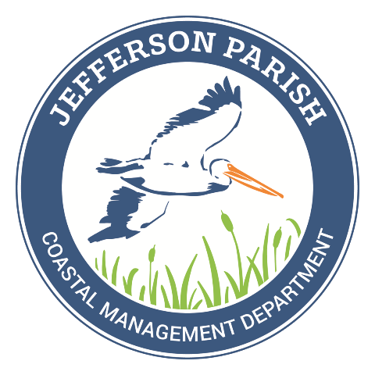
COASTAL 101 Jefferson Parish Coastal Restoration

Slide 2
WHAT WE DO
Steward restoration projects
Educate our parish on coastal issues
Issue permits for construction, development, and production activities
Coastal Funding Management & Development

Slide 3
TODAY’S QUESTIONS
Why is Jefferson’s coast important?
How did the delta form?
What impact did levees have?
What can we do?

Slide 4
PROBLEM TO SOLVE
COASTAL LAND LOSS IN LOUISIANA

Slide 5
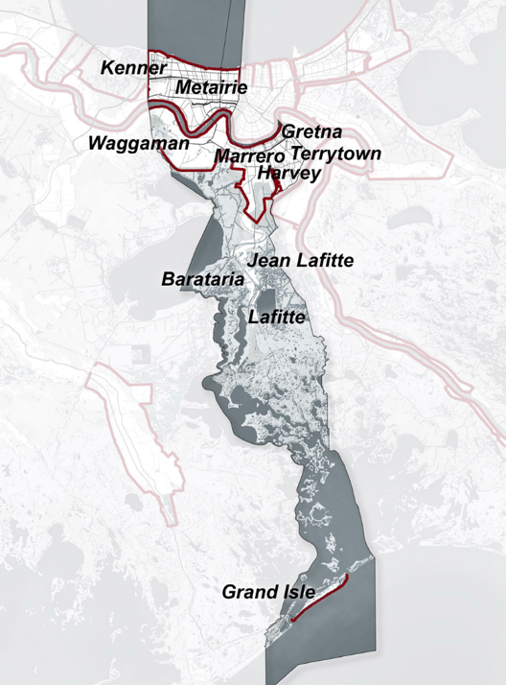
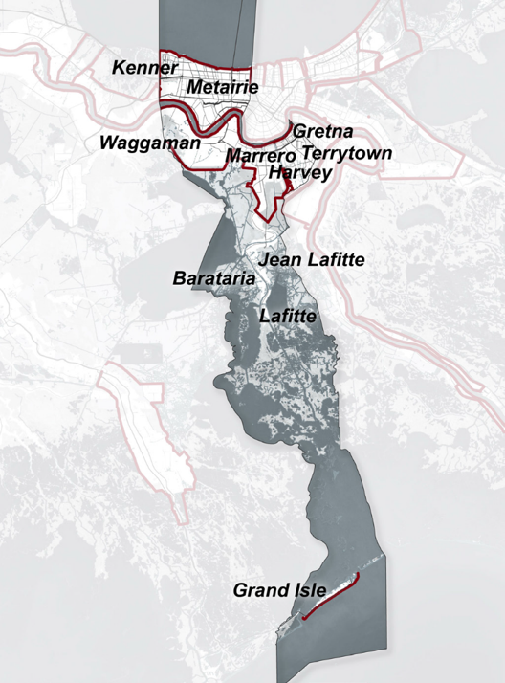
HISTORIC LAND LOSS
Coastal Overview
30%
Land Loss in 57 years
1960
2017
Notes:
Land loss is a gradual process, but it adds up. Between 1960 and 2017, Jefferson parish lost 30% of its land.

Slide 6
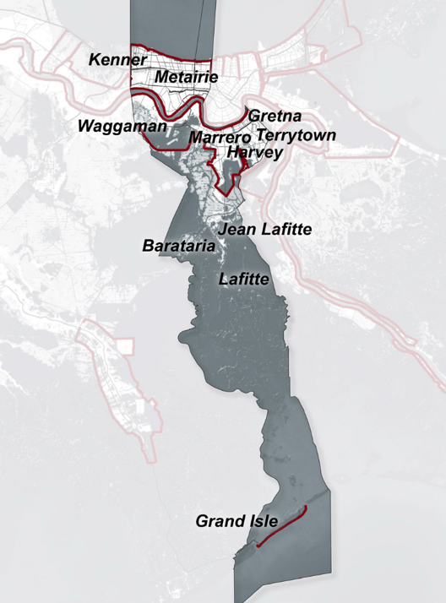
FUTURE LAND LOSS: NO PLAN
Coastal Overview
112
SQUARE MILES
or
42%
in 50 years
2067
WITHOUT PLAN
Equivalent to Boston falling into the Atlantic
Notes:
Without human action, we will lose an estimated additional 112 square miles by 2067 – that’s like the entire city of Boston falling away.

Slide 7
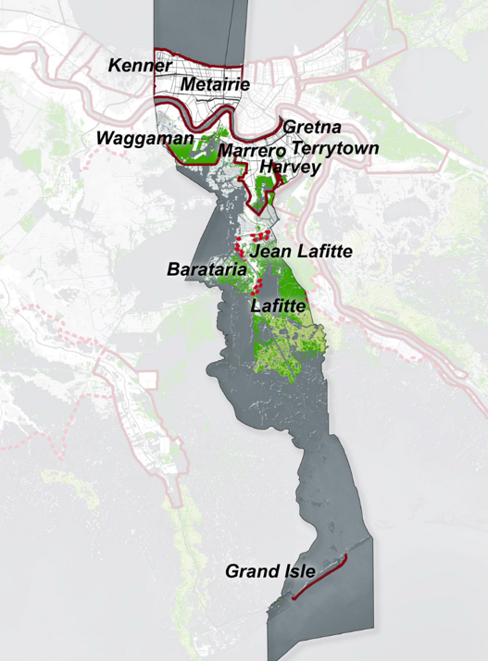
FUTURE WITH PLAN
Coastal Overview
89
SQUARE MILES
gained or maintained with 2017 COASTAL PLAN
2067
WITH PLAN
Notes:
With action, we estimate gaining or maintaining 89 of those miles over the next few decades.

Slide 8
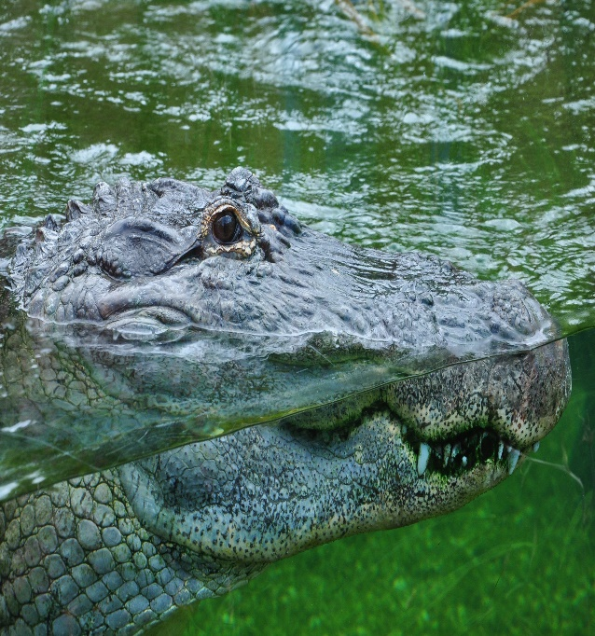
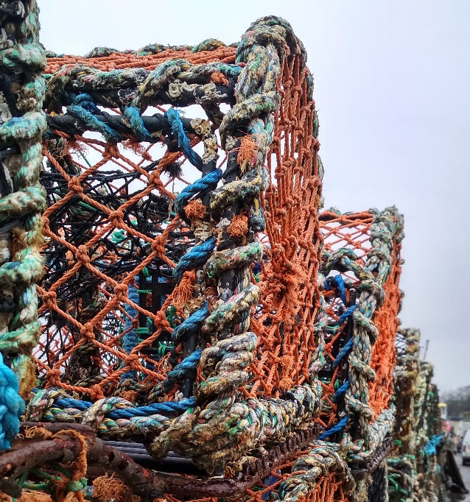
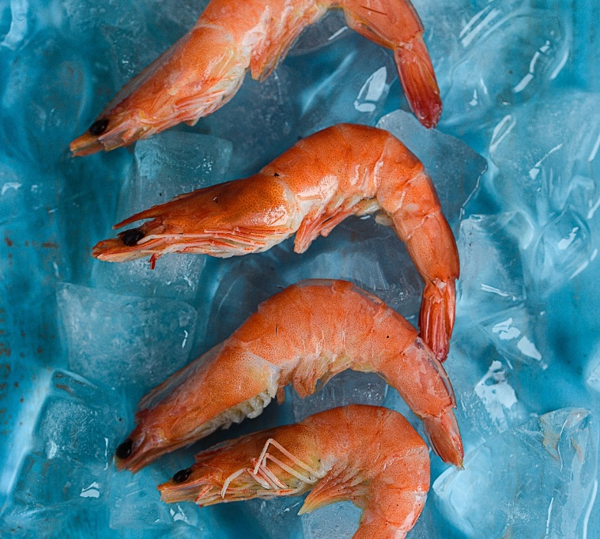
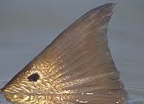
WHY IS JEFFERSON’S COAST IMPORTANT?
Coastal Overview
WILDLIFE
RECREATION
JOBS AND INDUSTRY
COMMUNITIES AND CULTURE
FISHERIES
CRITICAL ECOSYSTEM
Notes:
Jefferson Parish’s coast is important for many reasons. It serves as habitat to fish, birds, and wildlife, and provides jobs and natural resources to the state.
We have communities like Jean Lafitte and Grand Isle, where the coast is an important part of life. Plus, you can’t have a fish fry without the fish.

Slide 9
WHY IS JEFFERSON’S COAST IMPORTANT?
Coastal Overview
STORM PROTECTION:
IT’S OUR FIRST LINE OF DEFENSE
Notes:
One thing you might not think about is that coastal areas are our first line of defense against hurricanes and other storms. Here you can see the multiple lines of defense that protect our communities against storm surge. Barrier islands, marshes, ridges – these natural features keep us safe.
We’ll get into some specifics later.

Slide 10
COASTAL FORMATION
Coastal Overview
GLACIER MELT
SEDIMENT
COASTAL PLAIN
Image credit: NASA
Notes:
Let’s back up a bit, and talk about how Louisiana formed. The Mississippi carried water and sediment down to the coast. Over time, this sediment built up and formed land. The river changed course many times, building up the Mississippi Delta as we know it.

Slide 11
DELTA LOBE FORMATION
Coastal Overview
Notes:
Here is a video showing the formation of Louisiana and its coast.

Slide 12
WHAT CHANGED?
Coastal Overview
The Great Mississippi Flood
of
1927
Notes:
As Louisiana’s population grew, the flooding became more problematic. In 1927, the Great Mississippi Flood was the most destructive river flood in U.S. history. Depths reached as much as 30 feet in some places, 16 million acres of land were inundated, and hundreds of thousands of people were displaced.

Slide 13
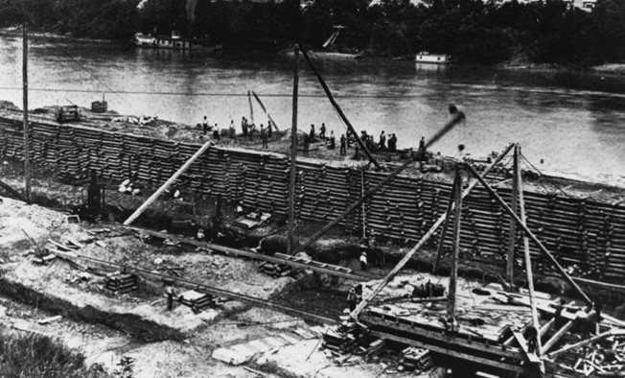
BUILDING NEW LEVEES
Coastal Overview
Army Corps of Engineers built new levees and improved existing ones
Flood Control Act of 1928
Notes:
In response, the U.S. Army Corps of Engineers was tasked with building levees to higher standards, and improving existing levees. What did this mean? Reduced flooding.

Slide 14
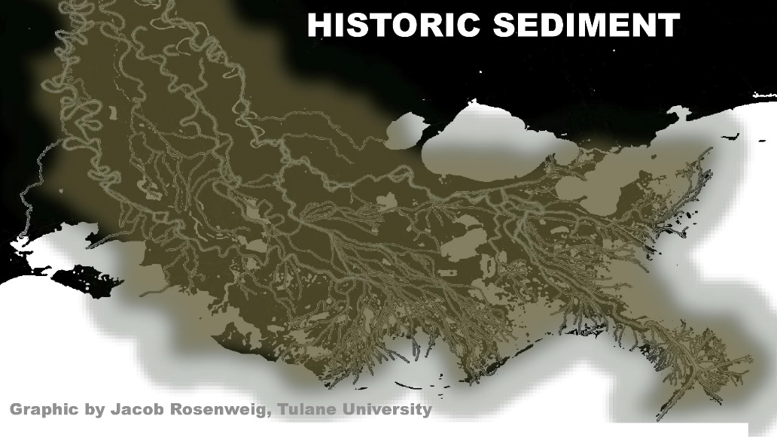
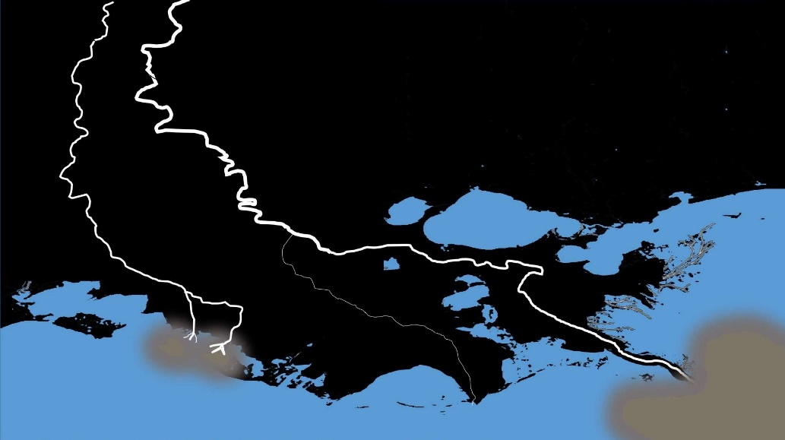
IMPACT OF LEVEES
Coastal Overview
Levees led to decreased flooding
NOW
Decreased flooding = less sediment deposited
Notes:
No flooding means sediment is not getting deposited, and freshwater is not getting delivered to the wetlands that need it.

Slide 15
OTHER CAUSES OF LAND LOSS
Coastal Overview
LEVEES
SUBSIDENCE
PIPELINE CANALS
OIL AND GAS INFRASTRUCTURE
STORMS
SEA LEVEL RISE
OIL SPILLS
Notes:
There are many other factors that contribute to land loss, both naturally occurring and caused by humans.

Slide 16
COASTAL FEATURE LEGEND
Barrier Islands & Beaches
Coastal Projects
Coastal Ridges
Wetlands (Marshes and Swamps)
Notes:
Here are a few of the coastal features we’ll be talking about. I’ll show you some examples in the coming slides.

Slide 17
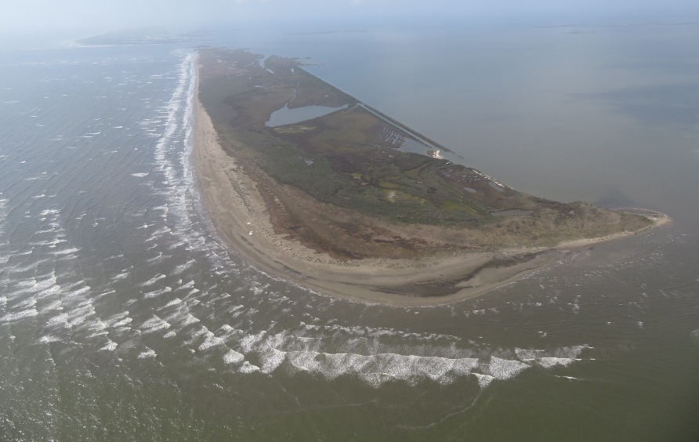
BARRIER ISLANDS & BEACHES
First speed bump
Parallel to mainland coast
Provides essential and critical habitat
Reduces wave energy
Coastal Projects
Notes:
Barrier islands are one of our first lines of defense. In this photo, you can see waves from the gulf on the left hitting the shore, while the water to the right is calm. Barrier islands reduce wave energy and protect our coast from erosion.

Slide 18
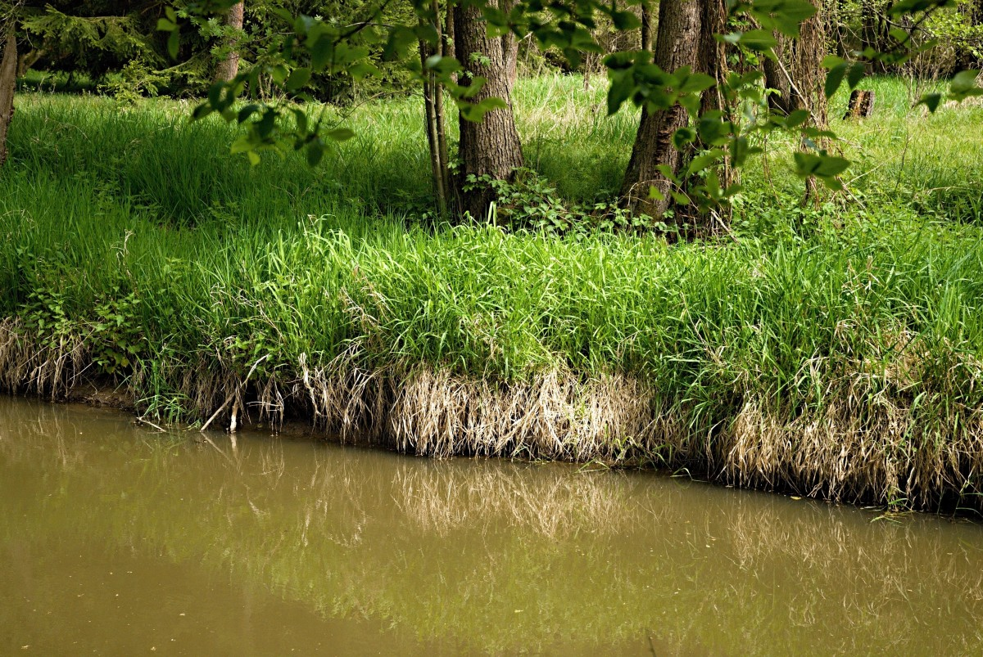
COASTAL RIDGES
Naturally elevated above marsh surface
Typically populated with trees
Coastal Projects
Serves as a natural levee
Impedes overland flow
Reduces shoreline erosion
Notes:
Ridges naturally form along the edges of marshes. They reduce erosion and serve as a natural levee.

Slide 19
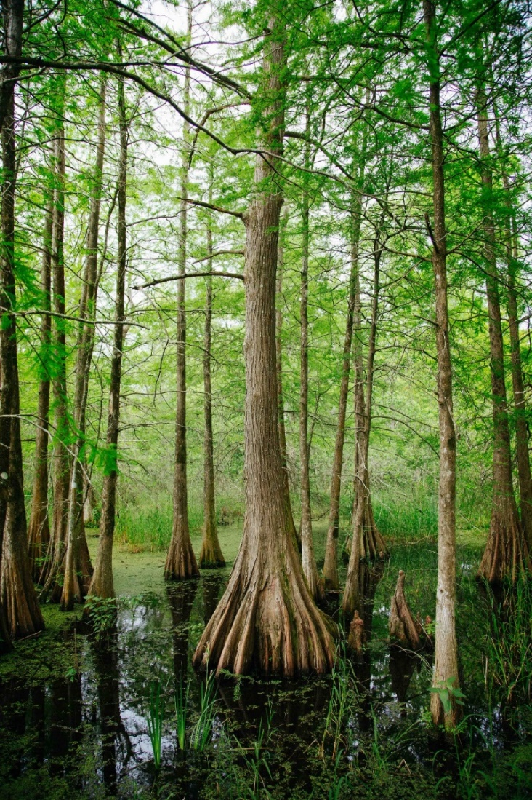
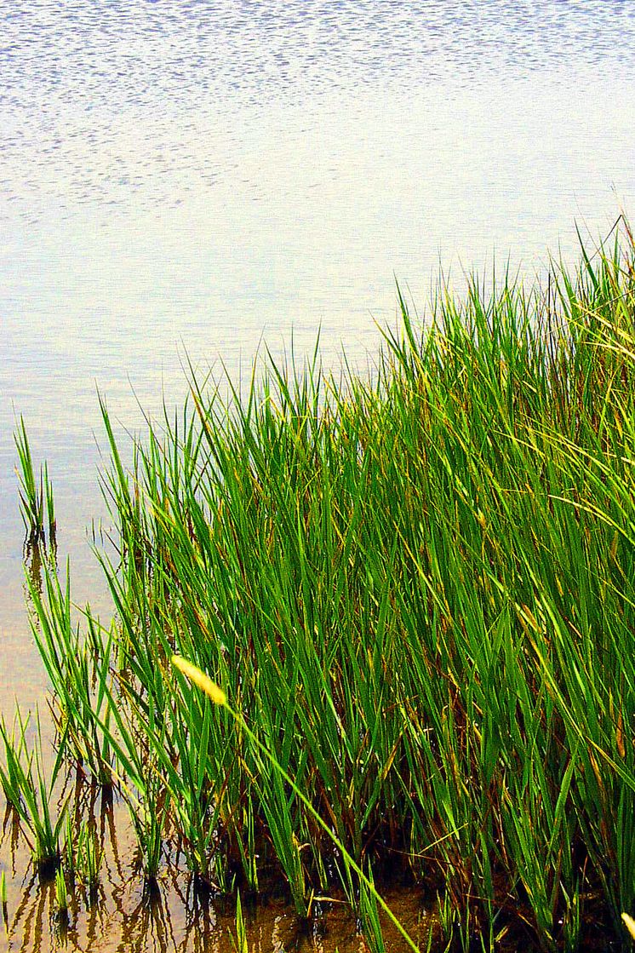
WETLANDS
\
Flood protection
Habitat
Fisheries
Improved Water Quality
SWAMP
MARSH
Coastal Projects
Supports woody growth
Primarily grasses and reeds
Notes:
Wetlands act as a “sponge” protecting our shores, reducing wave energy and protecting us from storm surge. Additionally, swamps and marshes serve as vital habitat to many species.

Slide 20
COASTAL PROJECT TYPES
Barrier Island Restoration
Coastal Ridge Restoration
Coastal Projects
Wetland Protection
Freshwater Diversion
Shoreline Protection / Living Shorelines
Notes:
Here are some of the different project types taking place in Jefferson Parish. Next, we will go over some examples of these projects.

Slide 21
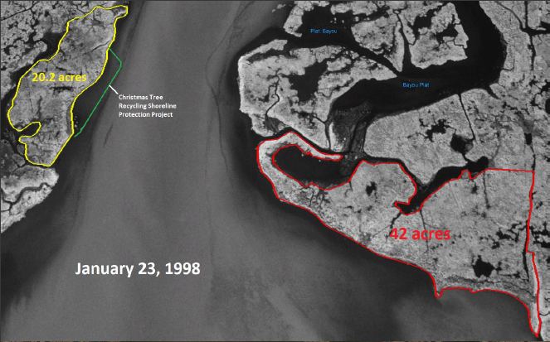
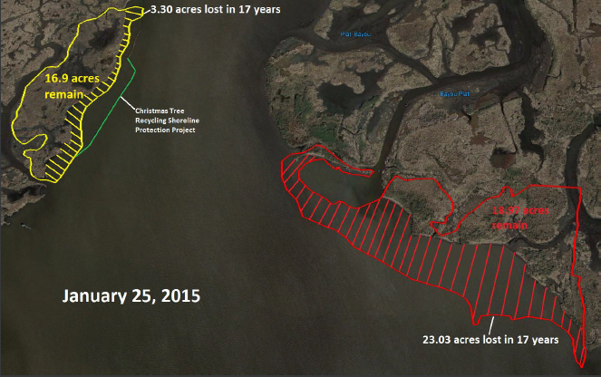
CHRISTMAS TREE RECYCLING PROJECT
Operating since 1991
Coastal Projects
Reduced erosion rates
4 ft/yr vs. 16 ft/yr

Slide 22
QUESTIONS?
Thank you!

